Slide 1
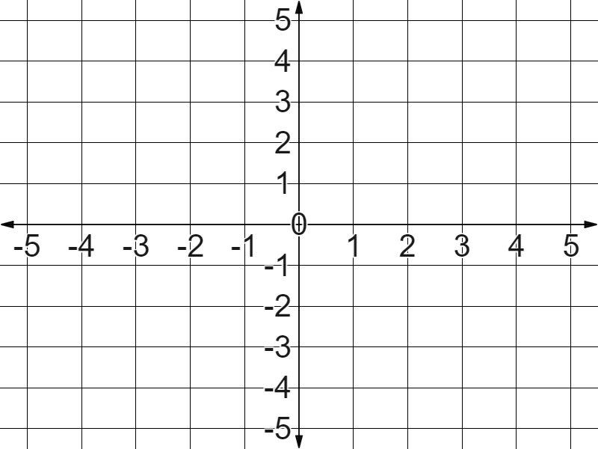
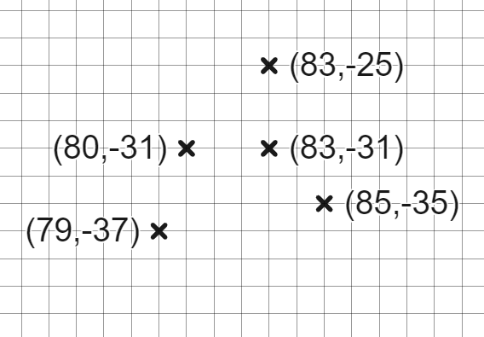
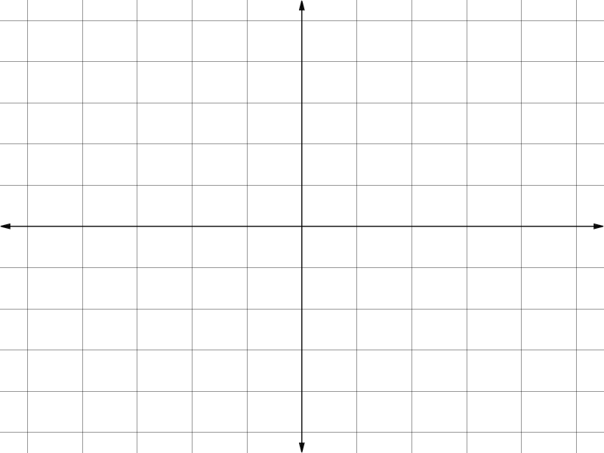
Checking and securing understanding of plotting coordinates
Task A: Plotting coordinates in all four quadrants
1) Plot the coordinates:
(5, 2)
(1, −1)
(−2, 3)
(−3, −4)
2) What are the the missing coordinates?
3) Solve these axes scale problems.
a) If coordinate A is (−6, 4) what are B and C?
b) If coordinate C is (−6, −40) what are A and B?
✖
B
✖
A
c) If coordinate B is (−40, 0) what are A and C?
✖
C

Slide 2
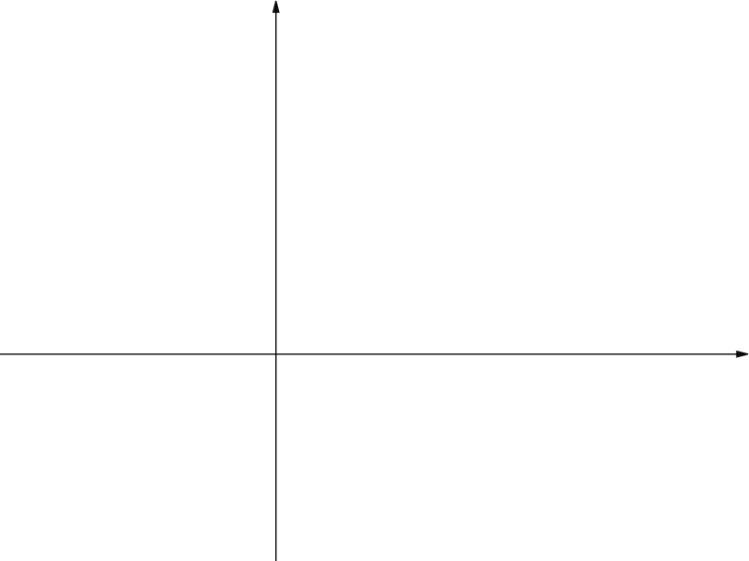
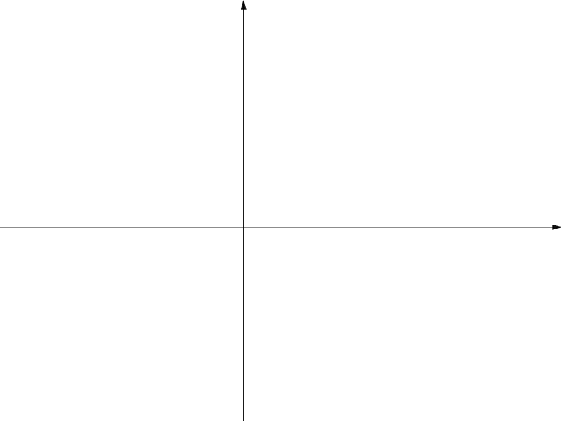
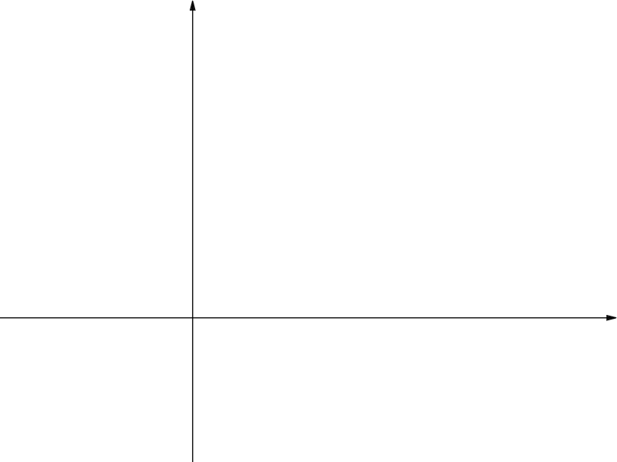
Checking and securing understanding of plotting coordinates
Task B: Coordinate problem solving with shapes
1) Find the missing coordinates.
A (9, 9)
✖
a) Three identical squares.
✖
B
C
✖
✖
D
b) Three identical rectangles.
✖
E
✖
D (2, 7)
−2
✖
A
B
✖
✖
C
2) a) Find the missing coordinates of this square.
✖
C (2, 5)
✖
D
✖
B (0, 0)
✖
A (5,−2)
b) Find the missing coordinates of these identical rectangles.
F (8, 34)
✖
G (22, 37)
✖
B (−5, 11)
✖
C (27, 19)
✖
✖
D (30, 5)
✖
✖
E (16, 2)
A (−2, −3)
Mathematics in Education and Industry
v2.2

